Slide 1
Web Application Testing SHEIN
Final Project
CLUJ-NAPOCA 2023

Slide 2
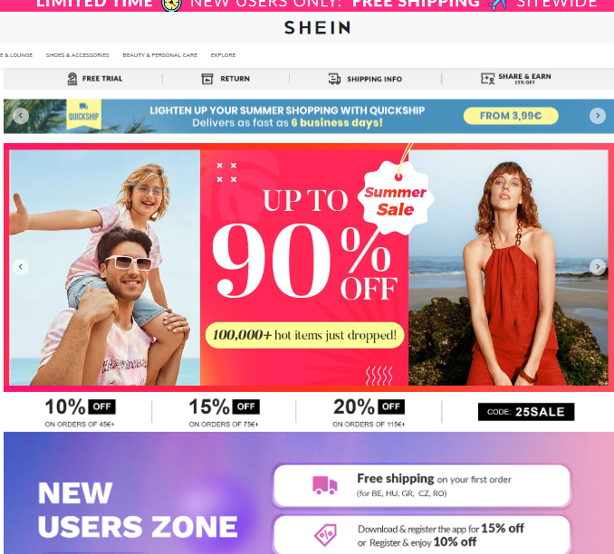
APP DESCRIPTION
SHEIN is a global fashion and lifestyle e-retailer committed to making the beauty of fashion accessible to all;
Web Application;
Grew to become the world's largest fashion retailer as of 2022;
Delivers to more than 150 countries and was valued at $100 billion after a funding round in April 2022;

Slide 3
TESTING APPROACH
Ad-hoc Testing to decide if the application is worth further testing;
Exploratory Testing for main functionalities;
Component Testing, Integration, System, System Integration Testing;
Focus where bugs were identified, more testing for that area
Write the Smoke tests and execute them
Write the Test Report

Slide 4
TOOLS USED
Mantis Bug Tracker – Bug Reporting
Snipping Tool – Screenshots Capture
Xmind Tool – Mind Maps
Microsoft PowerPoint Slide Presentation Software
Microsoft Excel Spreadsheet Software - Test case template

Slide 5
TESTING TYPES
Performed :
Functional Testing
Exploratory Testing
Negative Testing
Positive Testing
Smoke Testing
Compatibility Testing
UI Testing
Usability Testing

Slide 6
BUGS OVERVIEW
3 bugs observed by performing the smoke testing :
Severity – minor
My account - Registration page
(the location selection process is difficult to use)
Priority - low
Severity – minor
Shopping cart
Remove a product from the shopping cart by editing the item quantity in the cart
Priority - low
Severity – Normal
Social Media Interactions
The share button is not active
Priority - Normal

Slide 7
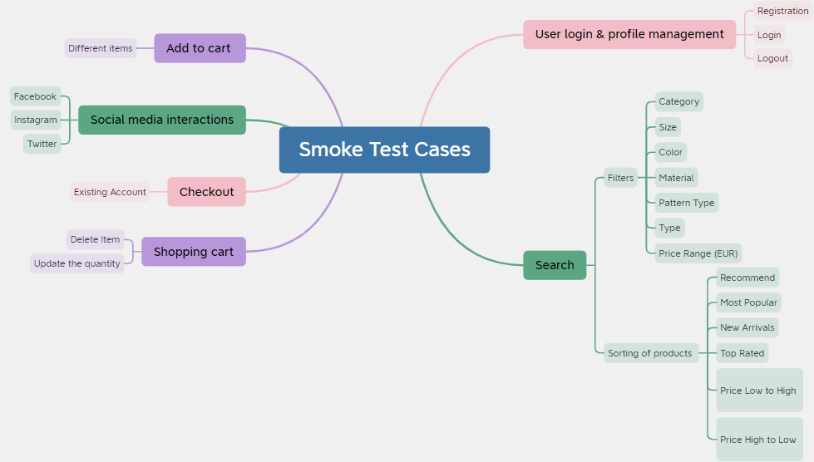
TEST CASES OVERVIEW

Slide 8
TEST CASES RESULTS
Functionality | Total | Pass | Failed | Blocked | Not run | Defects
My account | 9 | 8 | 1 | 0 | 0 | 0052428
Search | 3 | 3 | 0 | 0 | 0 | -
Add to Cart | 1 | 1 | 0 | 0 | 0 | -
Shopping Cart | 3 | 2 | 1 | 0 | 0 | 0052430
Checkout | 1 | 1 | 0 | 0 | 0 | -
Social Media Interaction | 4 | 3 | 1 | 0 | 0 | 0052432
Overall Results | 21 | 18 | 3 | 0 | 0 | 3
Percentage | 100% | 85.71% | 14.28% | 0.0% | 0.0% | 15%

Slide 9
CONCLUSIONS
21 Test Cases were executed to test the happy flows:18 passed and 3 failed;
3 bugs identified by performing smoke testing;
Most of the bugs were identified by performing Smoking and Exploratory Testing;
Data type used during testing: Blank, Valid, Invalid, Big Data;
Fixing at least the bugs obtained by performing the smoke testing;

Slide 10

LESSONS LEARNED
Difficulty in finding bugs with no requirements;
Pay more attention to details;
Understand better the user expectations;
Appreciate the importance of writing only essential and valid steps in test case description;

Slide 11


